Slide 1


Robert Chase
October 7, 2023

Slide 2
Executive Summary
Introduction
Methodology
Results
Conclusion
Appendix
Outline

Slide 3

We’ve used a series of Data Science methodologies to analyze the data. A short list is as follows:
Data Collection, Sampling, and Wrangling
Webscraping and API
Beautiful Soup
Exploratory Analysis using SQL, Pandas, and Matplotlib
Visual Analytics and Dashboarding
Predictive Analysis
Summary of all results
Exploratory Data Analysis results
Interactive analytics in screenshots
Predictive Analytics results
Executive Summary

Slide 4

The Problem: We need to analyze the cost of each rocket launch and the success of the landing and predict the probability of reuse of the first stage of rocket propulsion.
Background: In the race to space, companies are now aiming to make space travel more affordable and cost effective, ultimately successful. However, with only a few players in the industry able to produce rockets for passenger travel at scale, we need to find solutions to more successful and cost effective space travel. Enter Space Y.
Context: Space X has found a way to make space travel relatively cheap, however, at Space Y, we want to make it even cheaper and more effective.
Introduction

Slide 5


Slide 6
Executive Summary
Data collection methodology:
Data was collected using SpaceX API and web scraping from Wikipedia.
Perform data wrangling
One-hot encoding was applied to categorical features
Perform exploratory data analysis (EDA) using visualization and SQL
Perform interactive visual analytics using Folium and Plotly Dash
Perform predictive analysis using classification models
How to build, tune, evaluate classification models
Methodology

Slide 7

The data was collected using various methods
Data collection was done using get request to the SpaceX API.
Next, we decoded the response content as a Json using .json() function call in order to turn it into a pandas dataframe using the _normalize() function.
We then cleaned the data, checked for missing values and fill in missing values where necessary.
In addition, we performed web scraping from Wikipedia for Falcon 9 launch records with BeautifulSoup.
The objective was to extract the launch records as HTML table, parse the table and convert it to a pandas dataframe for future analysis.
Data Collection

Slide 8

We used the requests.get() to collect the data from the SpaceX API, clean the requested data and did some basic data wrangling and formatting.
The link to the notebook is https://github.com/robbthe/IBM_Data_Science_Capstone/blob/main/jupyter-labs-spacex-data-collection-api.ipynb
Data Collection – SpaceX API

Slide 9


Data Collection - Scraping
We applied web scrapping to retrieve Falcon 9 launch records using the BeautifulSoup Method.
We parsed the table and converted it into a pandas dataframe.
The link to the notebook is https://github.com/robbthe/IBM_Data_Science_Capstone/blob/main/jupyter-labs-webscraping.ipynb

Slide 10

We performed exploratory data analysis and determined the training labels.
We calculated the number of launches at each site, and the number and occurrence of each orbits
We created landing outcome label from outcome column and exported the results to csv.
The link to the notebook is https://github.com/robbthe/IBM_Data_Science_Capstone/blob/main/labs-jupyter-spacex-data_wrangling_jupyterlite.jupyterlite.ipynb
Data Wrangling

Slide 11


EDA with Data Visualization
We explored the data by visualizing the relationship between:
Flight Number vs. Launch Site,
Payload vs. Launch site,
The success rate of each Orbit Type
Flight number vs. Orbit
The launch success yearly trend.
https://github.com/robbthe/IBM_Data_Science_Capstone/blob/main/jupyter-labs-eda-dataviz.ipynb.jupyterlite.ipynb

Slide 12
We loaded the SpaceX dataset into a PostgreSQL database. Then we applied EDA with SQL to get insights from the data. We queried the data to discover different attributes related to the launches such as Payload Mass, Launch Site, Orbit Types, etc.
The link to the notebook https://github.com/robbthe/IBM_Data_Science_Capstone/blob/main/jupyter-labs-eda-sql-coursera_sqllite.ipynb
EDA with SQL

Slide 13
We marked all launch sites, and added map objects such as markers, circles, lines to mark the success or failure of launches for each site on the folium map.
We assigned the feature launch outcomes (failure or success) to class 0 and 1.i.e., 0 for failure, and 1 for success.
Using the color-labeled marker clusters, we identified which launch sites have relatively high success rate.
We calculated the distances between a launch site to its proximities. We answered some question for instance:
Are launch sites near railways, highways and coastlines.
Do launch sites keep certain distance away from cities.
Build an Interactive Map with Folium

Slide 14

We built an interactive dashboard with Plotly dash
We plotted pie charts showing the total launches by a certain sites
We plotted scatter graph showing the relationship with Outcome and Payload Mass (Kg) for the different booster version.
The link to the notebook is https://github.com/chuksoo/IBM-Data-Science-Capstone-SpaceX/blob/main/app.py
Build a Dashboard with Plotly Dash

Slide 15

We loaded the data using numpy and pandas, transformed the data, split our data into two groups for training and testing.
We built different machine learning models in order to tune different hyperparameters using GridSearchCV.
We used accuracy as the metric for our model, improved the model using feature engineering and algorithm tuning.
As a result, after comparative analysis, we found the best classification model.
The link to the notebook is https://github.com/robbthe/IBM_Data_Science_Capstone/blob/main/SpaceX_Machine_Learning_Prediction_Part_5.jupyterlite.ipynb
Predictive Analysis (Classification)

Slide 16

Exploratory data analysis results
Interactive analytics demo in screenshots
Predictive analysis results
Results

Slide 17


Slide 18
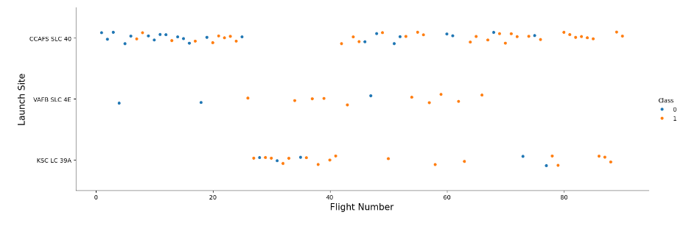
Flight Number vs. Launch Site
From the plot, we found that the larger the flight amount at a launch site, the greater the success rate at a launch site.

Slide 19
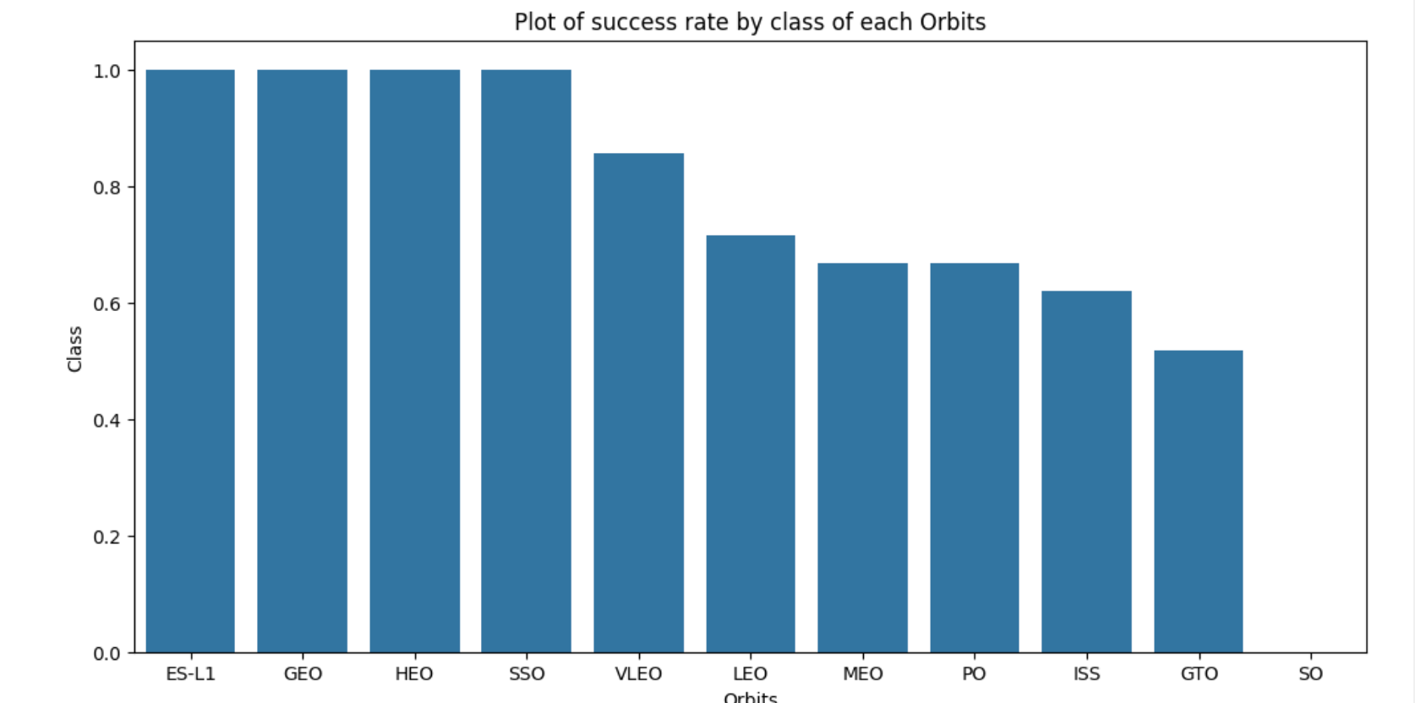
Success Rate vs. Orbit Type
From the plot, we can see that ES-L1, GEO, HEO, and SSO had the best success rates.

Slide 20
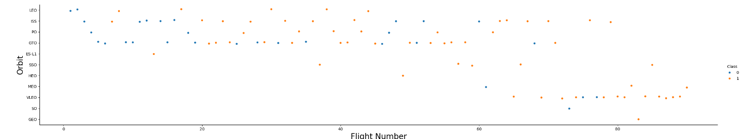
Flight Number vs. Orbit Type
The plot shows the Flight Number vs. Orbit type. We observe that in the LEO orbit, success is related to the number of flights whereas in the GTO orbit, there is no relationship between flight number and the orbit.

Slide 21
Launch Success Yearly Trend
From the plot, we can observe that there has been a continuous increase in the launch success, with the exception for a dip around 2019, likely due to COVID and the resulting economic strain.

Slide 22

Boosters Carried Maximum Payload
We determined the booster that have carried the maximum payload using a subquery in the WHERE clause and the MAX() function.

Slide 23

Rank Landing Outcomes Between 2010-06-04 and 2017-03-20
We selected Landing outcomes and the COUNT of landing outcomes from the data and used the WHERE clause to filter for landing outcomes BETWEEN 2010-06-04 to 2010-03-20.
We applied the GROUP BY clause to group the landing outcomes and the ORDER BY clause to order the grouped landing outcome in descending order.

Slide 24


Slide 25

All launch sites global map markers

Slide 26

Markers showing launch sites with color labels

Slide 27

Launch Site distance to landmarks

Slide 28


Slide 29

Pie chart showing the success percentage achieved by each launch site

Slide 30

Pie chart showing the Launch site with the highest launch success ratio

Slide 31

Scatter plot of Payload vs Launch Outcome for all sites, with different payload selected in the range slider

Slide 32


Slide 33

Classification Accuracy
The decision tree classifier is the model with the highest classification accuracy

Slide 34

Confusion Matrix
The confusion matrix for the decision tree classifier shows that the classifier can distinguish between the different classes. The major problem is the false positives .i.e., unsuccessful landing marked as successful landing by the classifier.

Slide 35
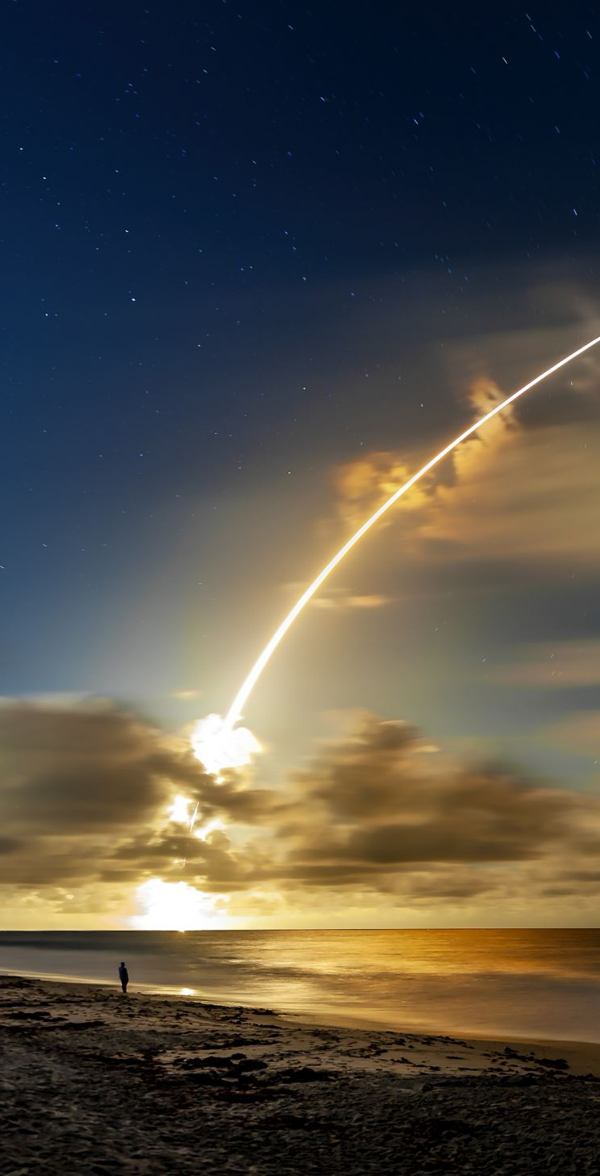
We can conclude that:
The larger the flight amount at a launch site, the greater the success rate at a launch site.
Launch success rate started to increase in 2013 till 2020.
Orbits ES-L1, GEO, HEO, SSO, VLEO had the most success rate.
KSC LC-39A had the most successful launches of any sites.
The Decision tree classifier is the best machine learning algorithm for this task.
Conclusions

Slide 36


